Slide 1
AC voltage regulator
The ac voltage regulator is a static circuit that accepts a variable ac voltage input and produces a regulated ac voltage output.
The output voltage is maintained for changes in input voltage, output load current, and load power factor. The input frequency is not changed, nor is the basic sinusoidal waveform modified. Since the input and output voltage is ac, thyristors with line commutation have been utilized.
This circuit is the static equivalent of the mechanical on-load tap changer. The thyristors are connected in inverse-parallel and provide a bidirectional connection from the tap on the autotransformer to the load. One tap is at a voltage lower than the input voltage; the other tap is at a higher voltage. In this manner, the input voltage can be either increased or decreased to produce a fixed voltage output. Output voltage control is provided by a closed-loop regulator that adjusts the firing angle of the two thyristors connected to the higher-voltage transformer tap. The gating on of these thyristors reverse biases the lower two thyristors, causing them to cease conducting the load current and transferring the load current to the higher-tap thyristors. More than two taps can be provided to develop a regulated output voltage with reduced harmonic content. The gating of the lower two thyristors is accomplished at the zero crossing of the load current. In this manner, the load current is initially in the lower tap irrespective of the load power factor. The transfer of load current at current zero allows the upper-tap thyristors to turn off and allows the lower-tap thyristors to conduct the load current. This transfer from upper to lower tap is at load-current zero crossing and is dependent on the load power factor. Therefore, the output voltage waveform and magnitude change with respect to the load power factor, putting an additional burden on the ac voltage regulator. Both three-phase and single-phase circuits with full isolation transformers have been fabricated. Where low harmonic distortion is required, an output filter can be provided.

Slide 2
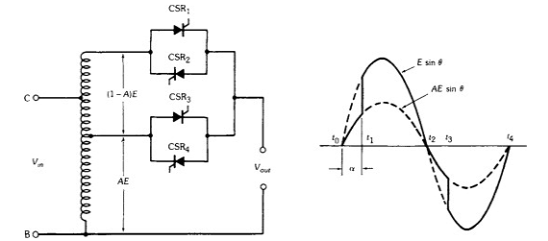

Slide 3
Controlled Rectifier
A controlled rectifier is the same as the uncontrolled rectifier except that the diode is replaced by the thyristor.
During the positive half cycle, the thyristor is forward biased but because of the absence of the gate signal it remains in forward blocking mode. As soon as the thyristor is turned ON by applying the gate signal at angle α, the thyristor comes into forward conduction mode and starts conducting. From the waveform of anode to cathode voltage (V_{AK})
we can see that the voltage is dropped across the thyristor until the gate signal is applied and after the application of the gate signal, the voltage starts appearing across the load. From π onward, the input voltage starts increasing in the reverse direction making the diode reverse biased, but the current through the inductor starts decaying and voltage across it builds up with opposite polarity until reaching the angle ϕ. From ϕ to 2π, the thyristor is reverse biased and all the input voltage is dropped across the thyristor and zero voltage across the load. After that the cycle repeats itself.

Slide 4
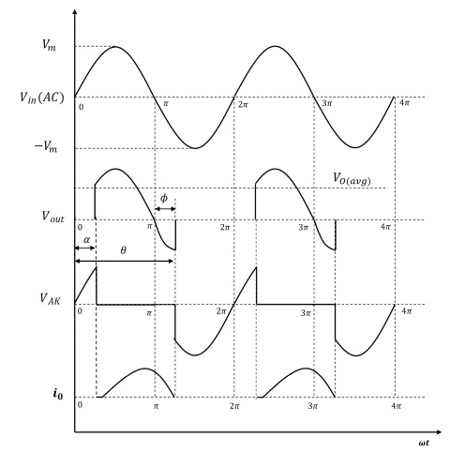
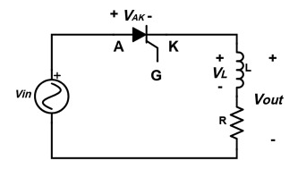

Slide 5
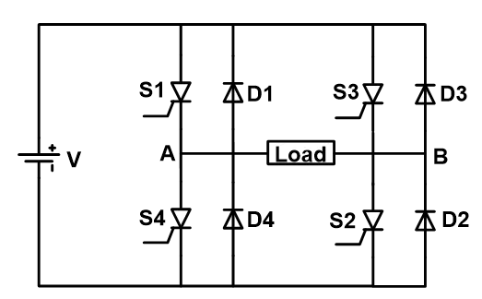
Inverters
An inverter (or power inverter) is a power electronics device which used to convert DC voltage into AC voltage. Although DC power is used in small electrical gadgets, most household equipment runs on AC power. Hence we need an efficient way to convert DC power into AC power.
When switch S1 and S2 are ON, S3 and S4 OFF, the direction of current through the load are positive in this condition. It gives a positive half cycle of the AC output.
Now, switch S3 and S4 is ON, S1 and S2 OFF. The current flowing in the opposite direction. It gives a negative half cycle of the AC output.
The ON and OFF time of switches decides the output frequency. The output of the inverter is a square wave. The filters used to generate a sine wave.

Slide 6
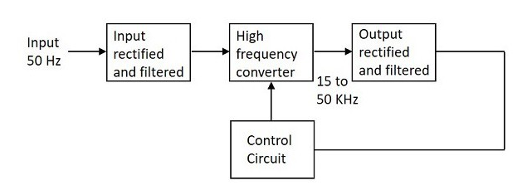
SMPS (Switched Mode Power Supply)
SMPS stands for switched mode power supply. It is known by a wide range of names like power supply, supply unit, regulator, or switcher in an electronic power supply. It incorporates a switching regulator to convert electrical power efficiently. It is mainly used for obtaining a controlled dc power supply as output.
It is used to convert power (voltage) using switching devices that are turned on and off alternatively at high frequencies. It uses storage components like inductors or capacitors to supply power when the switching device is in its non-conduction state (off-state). SMPS possesses high efficiency and is widely used in various electronic equipment such as computers, battery chargers, and other sensitive equipment requiring a stable and efficient power supply.

Slide 7
UPS (Uninterruptible Power Supply)
An Uninterruptible Power Supply (UPS) is defined as a piece of electrical equipment which can be used as an immediate power source to the connected load when there is a failure in the main input power source.
In a UPS, the energy is generally stored in flywheels, batteries, or super capacitors. When compared to other immediate power supply system, UPS have the advantage of immediate protection against the input power interruptions.
It has very short on-battery run time; however this time is enough to safely shut down the connected apparatus (computers, telecommunication equipment etc) or to switch on a standby power source.
UPS can be used as a protective device for some hardware which can cause serious damage or loss with a sudden power disruption.
Uninterruptible power source, Battery backup and Flywheel back up are the other names often used for UPS. The available size of UPS units ranges from 200 VA which is used for a solo computer to several large units up to 46 MVA

